Slide 1

ECS 351L and 851L : Geospatial Data Science
Bonus lecture: Previous class projects
Email: jonathan.ryan@duke.edu
Office: 3101 Grainger Hall
Office hours: Mondays and Wednesdays 15:00-16:00

Slide 2
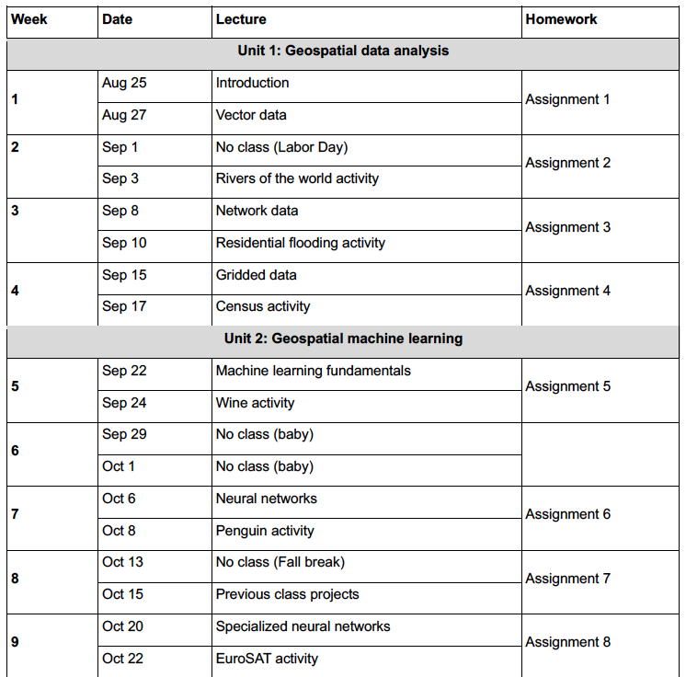

Slide 3
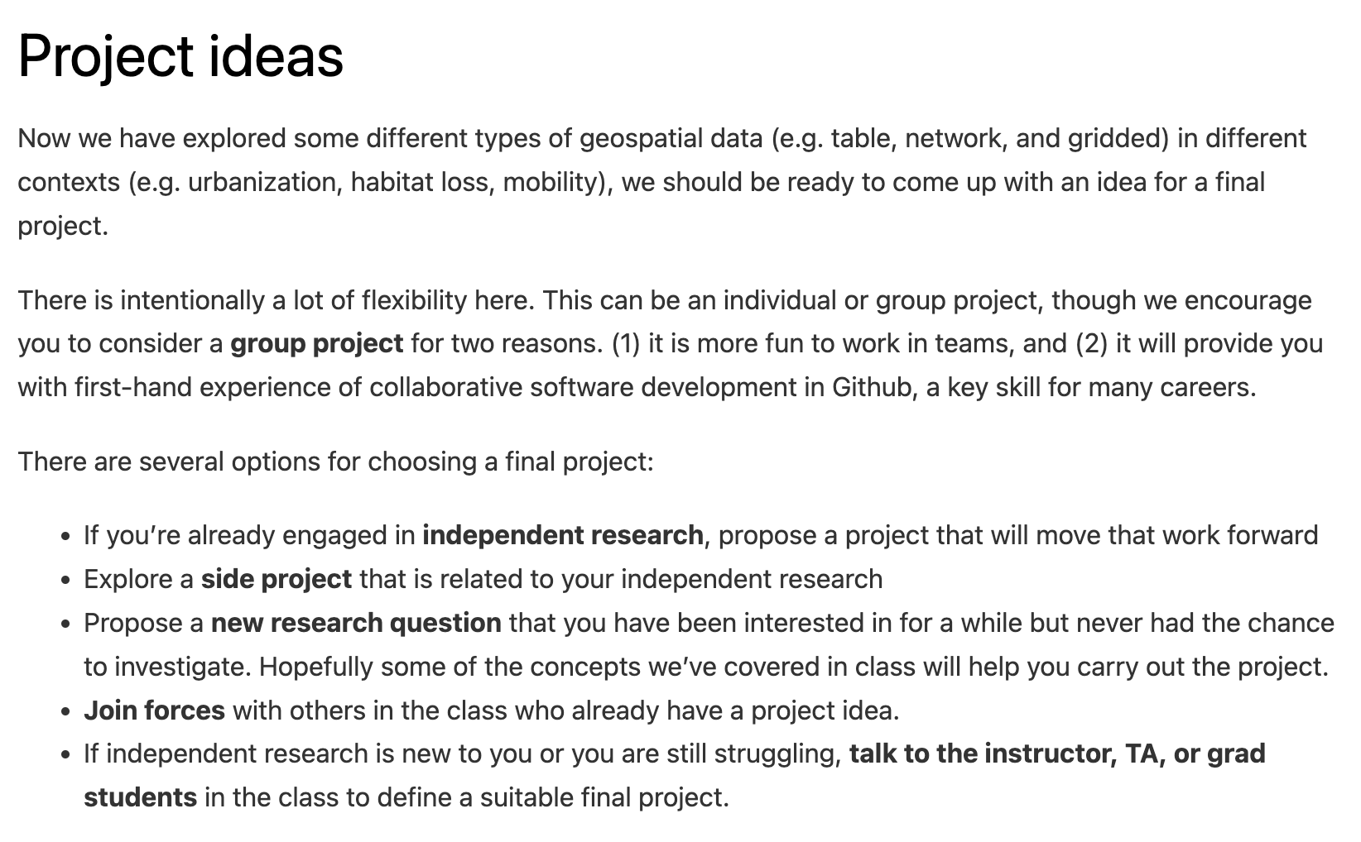
Assignment 7 (due Oct 22)

Slide 4
Assignment 7 (due Oct 22)

Slide 5
Assignment 7 (due Oct 22)

Slide 6
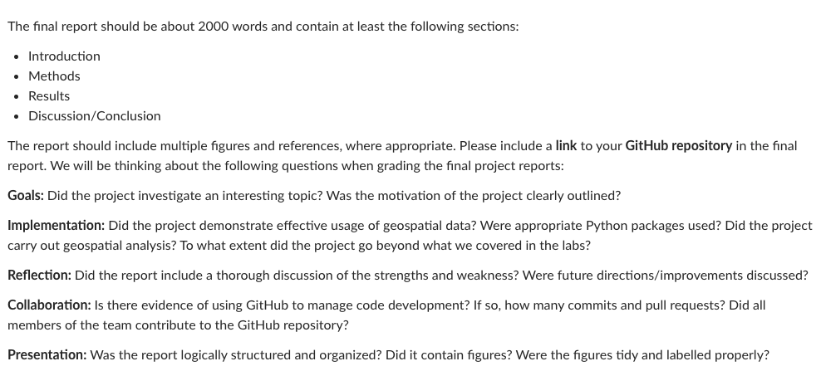
Final project report (due Dec 5)

Slide 7
Final project report (due Dec 5)

Slide 8
Final project report (due Dec 5)

Slide 9
Final project presentations (week starting Dec 1)
10-minute presentation with 2 minutes for questions
10 slides, one minute per slide
Similar structure to final project reports

Slide 10
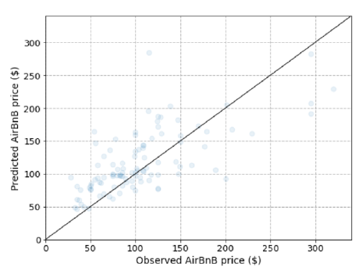
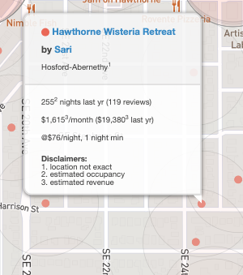
Machine learning AirBnB rates in Portland
https://insideairbnb.com/

Slide 11
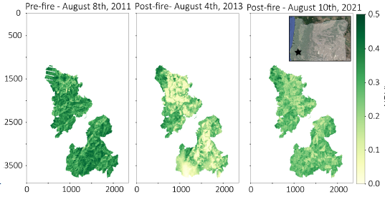
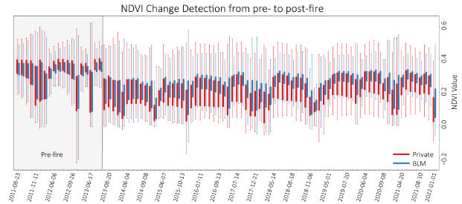
Post-fire Vegetation Recovery for the Douglas Fire Complex, Oregon
Notes:
92 Landsat images in Google colab

Slide 12
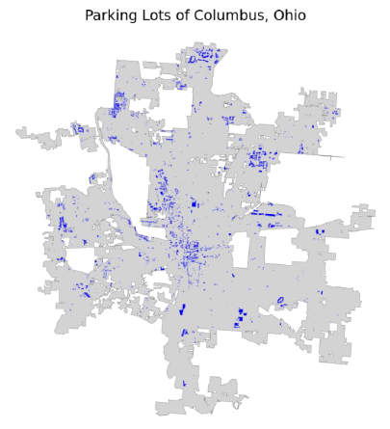
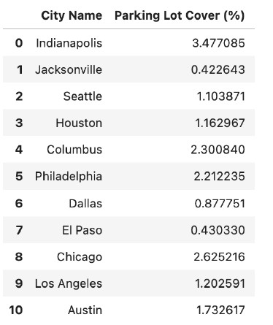
Parking lot surface area coverage in U.S. Cities
OSMnx to download geospatial data from OpenStreetMap that contained the tag “parking”

Slide 13
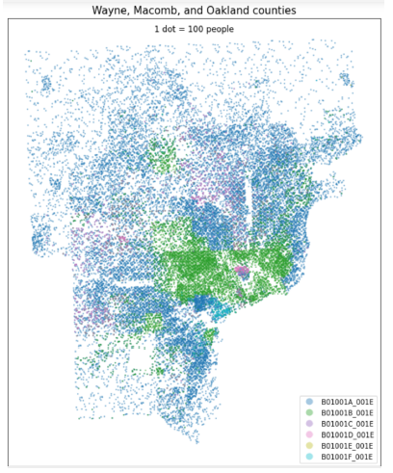
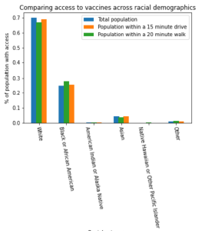
Spatial distributions of COVID-19 vaccine availability according to race
OSMnx to download street network data from OpenStreetMap to compute walking and driving distances to nearest vaccination clinic.
census package to download population and race/ethnicity data for Detroit, Michigan
Notes:
Detroit

Slide 14
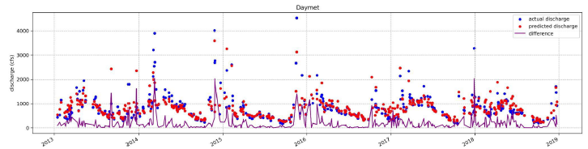
Machine learning the discharge of the Nisqually River
Notes:
Detroit

Slide 15
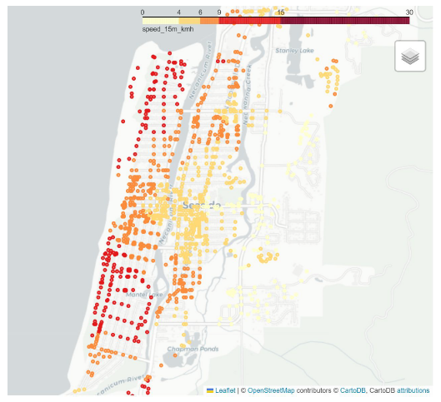
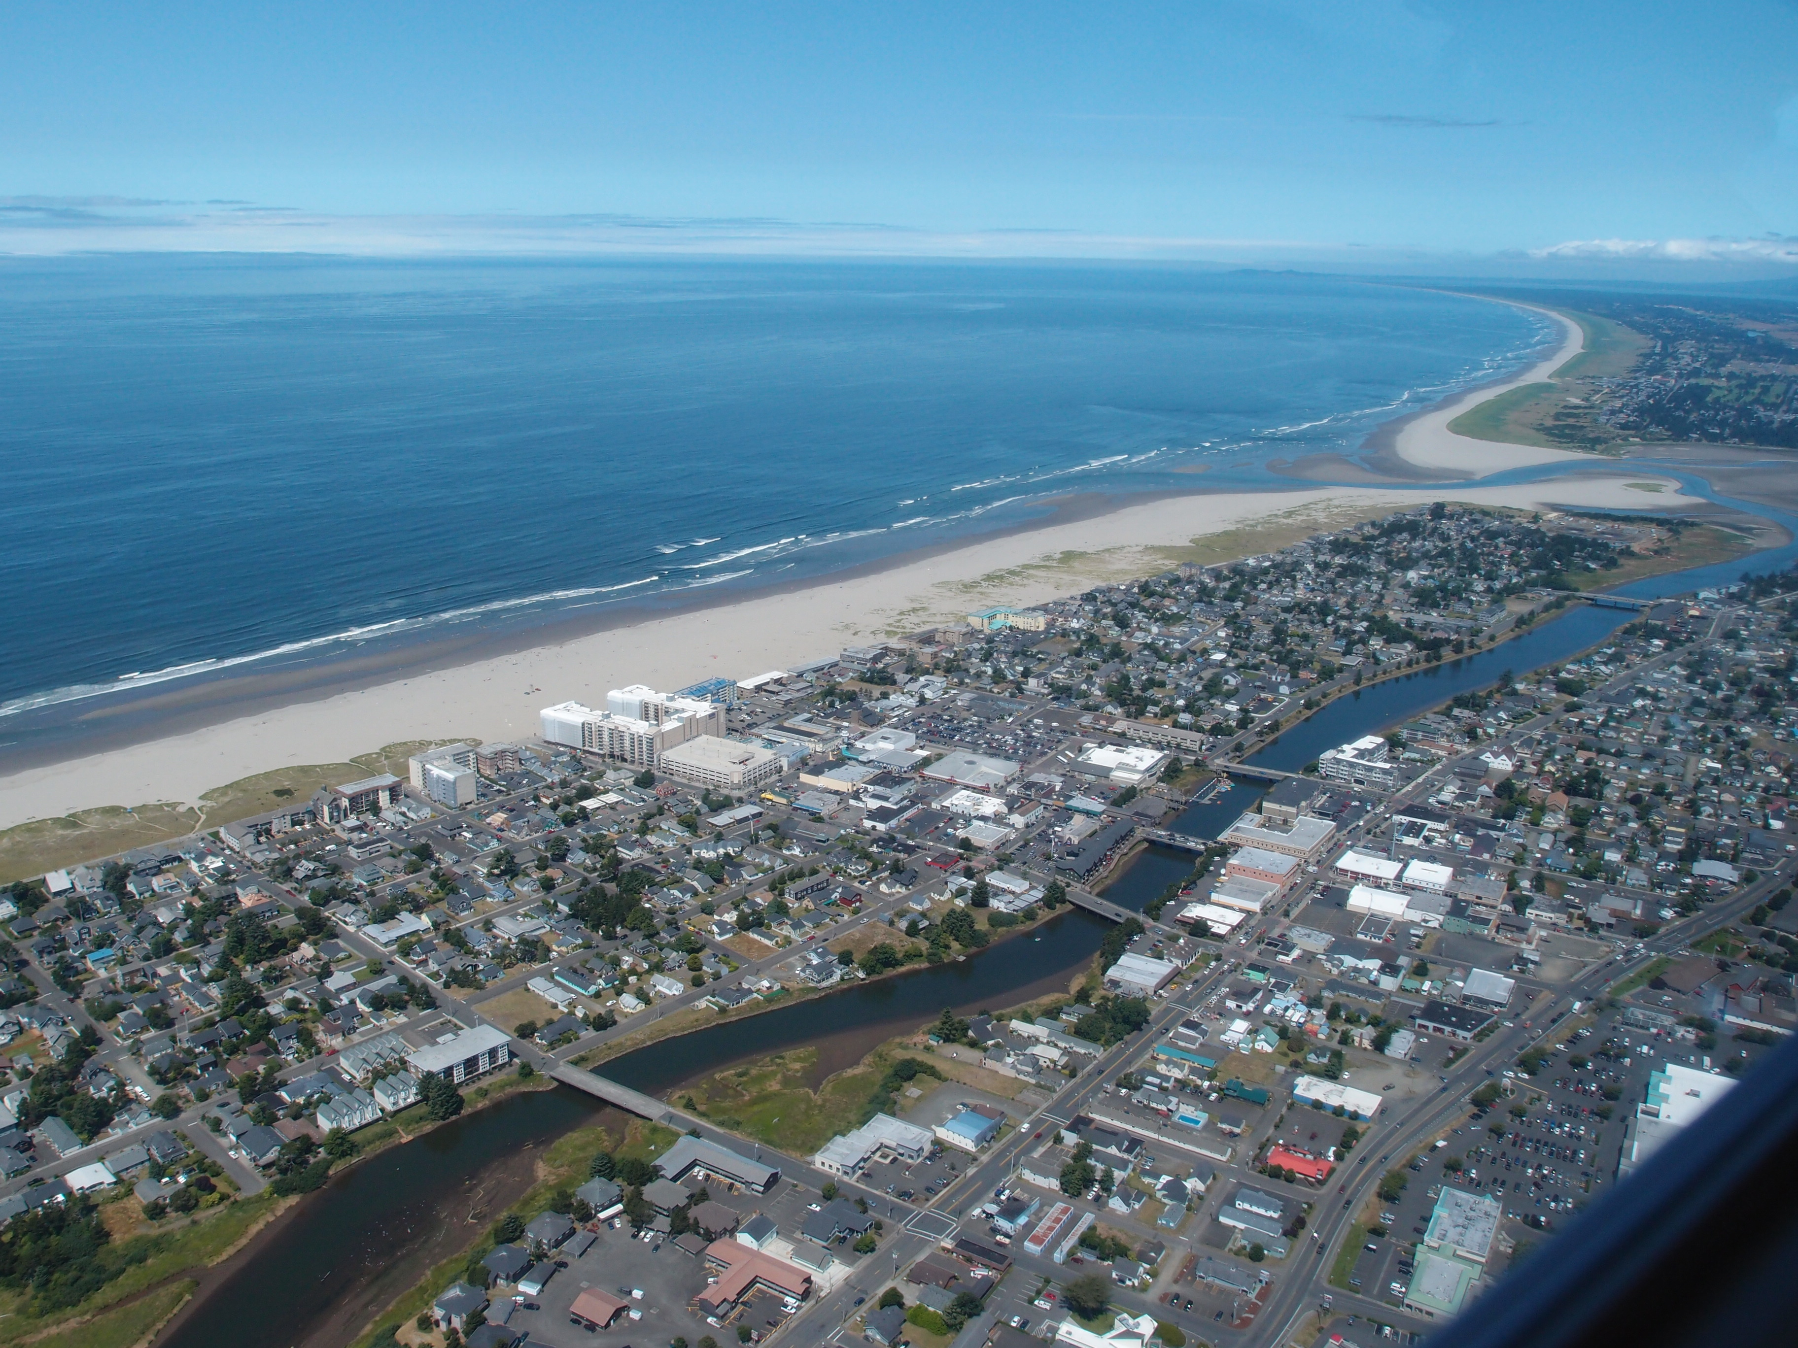
Evacuation times for the XXL Cascadia Tsunami
Seaside, OR
Notes:
Within the next 50 years, there is a 37% chance of a megathrust earthquake occurring along the Cascadia Subduction Zone (OEM). Once the shaking begins -- possibly lasting four to six minutes -- some
areas will see the first waves reach the shore in 15 to 30 minutes

Slide 16
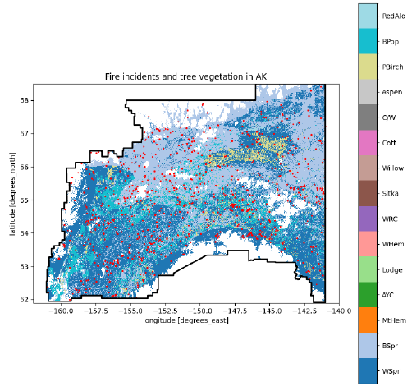
Predicting wildfire size in Alaska using machine learning
Notes:
Seaside Oregon

Slide 17
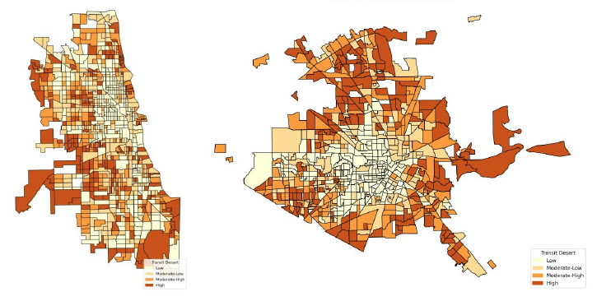
Identifying Transit Deserts: A Case-Study of Chicago and Houston
Transit desert = transit demand – transit supply
Notes:
Seaside Oregon

Slide 18
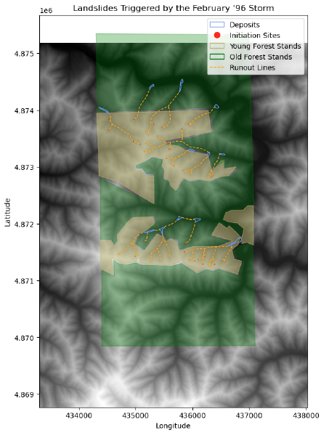
Vegetation influence on debris flow initiation in Oregon
Notes:
Seaside Oregon

Slide 19
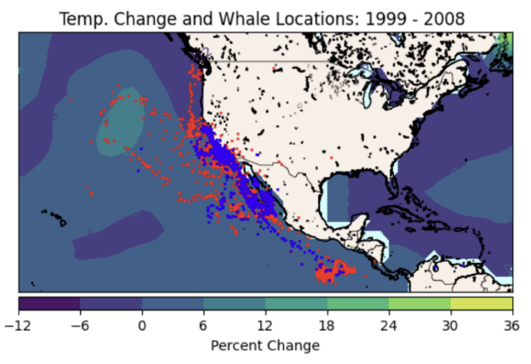
Blue Whale migration in the North Pacific Ocean between 1999 and 2008
Notes:
Seaside Oregon

Slide 20
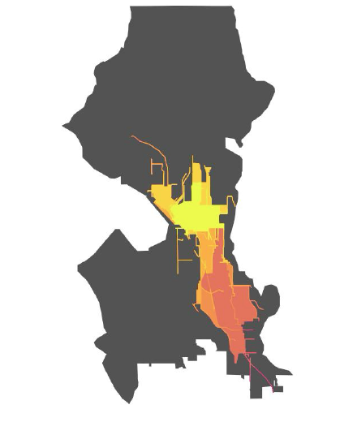
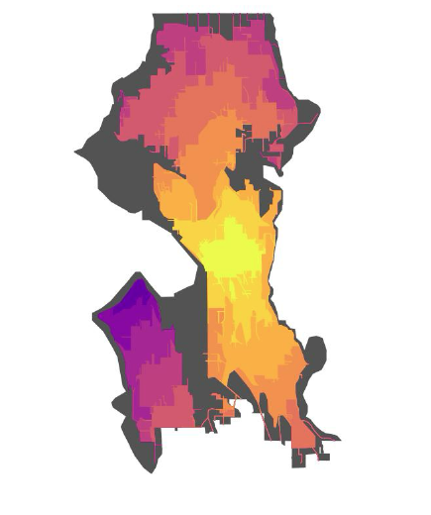
Bike connection and accessibility in Seattle
Notes:
Seaside Oregon

Slide 21
Some takeaways
Generate a clear and specific research question or goal
Define the objectives you need to address the research question or goal
Read broadly to find articles that have done something similar and either:
Adopt their methods to a new location or study site
Approach their research question or goal with new methods (e.g. deep learning)
Examples of titles that are too descriptive and limited:
“Temporal analysis of NDVI in Northern California”
“Land cover change in Bentonville, Arkansas”
Examples of titles that are too complex:
“Modeling with Stale Data: Does Disaster Insurance Need an Overhaul in the Face of Climate Change?”
“Deep seated landslide kinematics”
Notes:
Seaside Oregon

Slide 22
Next time: Specialized neural networks
Email: jonathan.ryan@duke.edu
Office: 3101 Grainger Hall
Office hours: Mondays and Wednesdays 15:00-16:00

